Slide 2
What is it?

Slide 3
How do you play?
From April 15 – September 15:
Tell your company your great green ideas
Pledge to take environmental actions
Download the mobile app
1
2
3
3
AWESOME PRIZES UP FOR GRABS EVERY MONTH

Slide 4
Give us your green ideas!
Go to:
www.partnersinprojectgreen.com/2016
Get your colleagues to give ideas to win the Suggestion Generator prize!
Click here!
Examples:
Add organics waste program
Set timers on meeting room lights
Start daycleaning program
Reuse excess paint on paint line

Slide 5
Pledge to take an environmental action!
Go to:
www.partnersinprojectgreen.com/2016
Examples:
I pledge to….
Turn off computer every night
Bring litterless lunches
Take transit or carpool to work
Click here!
Tweet a pic with your pledge for extra points!
#PPC2016

Slide 6
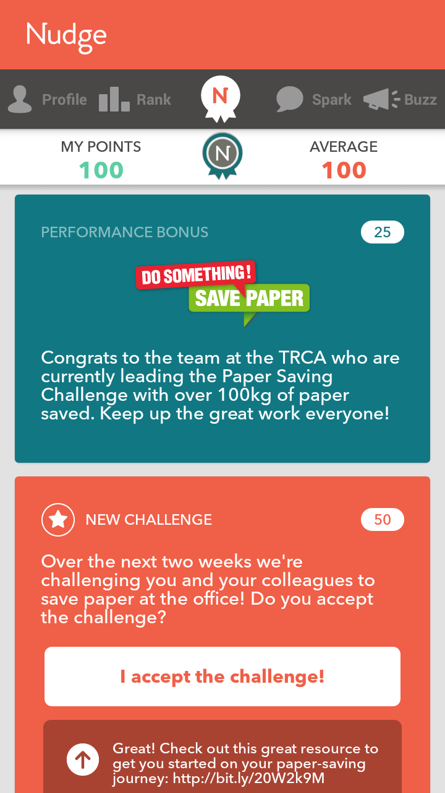
Download the Mobile App
Starting April 1st:
Go to your app store (Blackberry, Android, iPhone)
Search for Nudge Rewards
Create account with your work email
Start racking up the points!

Slide 7
Win prizes!
Every month:
1
MVP: The individual deemed to be the most valuable player at each organization will win a prize worth $30 - 50
APP ENGAGMENT: The top app user at each organization will be entered into a draw to win a prize worth $200-300
SUGGESTION GENERATOR: The organization who gets the most suggestions will get a group activity (e.g. Behind the Scene tour at Toronto Zoo)
2
3
1st Place $6,500
2nd Place $3,500

Slide 8
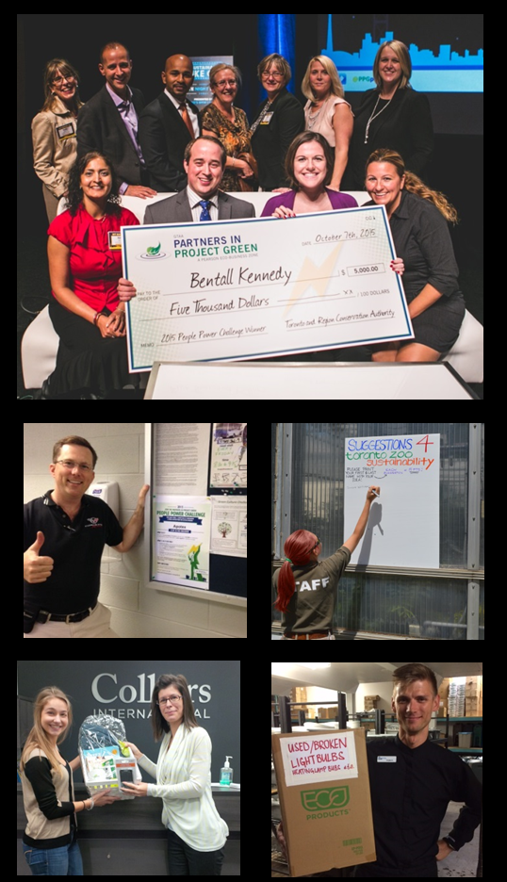
Questions
Your Challenge Champion:
ENTER CHAMPION NAME
ENTER CHAMPION PHONE
ENTER CHAMPION EMAIL

